Slide 1
Maintenance Planner/Supervisor

Slide 2

Welcome
This course is an introduction for the Maintenance Planners and Supervisors and how they manage Planning responsibilities using SAP. This course targets the Planners, however Supervisors must also be aware of the daily activities involved with navigating SAP. During the course, we are going to:
Prepare you for what is new or changing
Tell you what you should be able to do
Show you how to complete transactions in SAP
Let you practice in a structured environment and learn from your mistakes
Help you use quick reference materials

Slide 3

Course Components
Participant Guide
  Concepts
  Check Your Understandings
Activity Guide
  Exercises/Demonstrations
Online Help
  Process and Procedure Documents
Job Aids
Course Evaluation

Slide 4





Housekeeping
Restroom and Exit locations
Help manage activities by starting and stopping on time
Feel free to
ask questions
A 15 minute break
will be taken
[approx] every 2 hrs
Training schedule
Actively listen and participate in presentations
Notes:
Notes:

Slide 5





Ground Rules
Sign the attendance sheet
Minimize side conversations
Silence cell phones and pagers
Check E-mail during breaks ONLY
Provide feedback to improve training
Do not work on computers during instructor presentations
Notes:
Notes:

Slide 6

Course Modules
This course is intended to introduce SAP to the Loudoun Water organization and how Loudoun Water business processes integrate with SAP. In this course participants learn about managing measurement points, managing work orders, and generating reports.
The course is composed of the following modules:
Module 1: SAP Overview
Module 2: Introduction and EAM Process Overview
Module 3: Manage Notifications
Module 4: Manage Work Orders
Module 5: Manage Planning Activities
Module 6: Analytics and Reports
Notes:
SAP is software that integrates and streamlines business processes that span various applications and data sources. Using SAP, you can access and display the data and transactions you use to complete your tasks. This course discusses the plant maintenance process and how it is integrated with SAP.

Slide 7

Course Objectives
Upon completion of this course, you should be able to:
Define key terms and definitions
Explain the SAP log on process
Explain the EAM process flow
Create notifications in SAP
View assigned work orders
Manage work orders
Create measurement points
Manage bill of materials
Commission/Decommission equipment
Return material to stock
Generate an ad hoc report
Identify Help resources

Slide 8
SAP overview
Module 1

Slide 9
Module Objectives
Upon completion of this module, you should be able to:
Log on to SAP ECC
Recognize typical ECC screen features
Recognize standard SAP buttons and icons
Differentiate between the SAP content menus
Notes:
This module introduces you to basic SAP navigation, including the basic screens, menus, transaction codes and buttons that you use frequently. The first step to learning SAP is to become familiar with SAP navigation. Understanding the skills presented in this module is necessary prior to completing other modules or courses.
As you continue to work on your own with the SAP system, you find that it offers several different ways of completing standard tasks. This great flexibility allows each user to develop personalized preferences for using navigation options and system shortcuts.

Slide 10
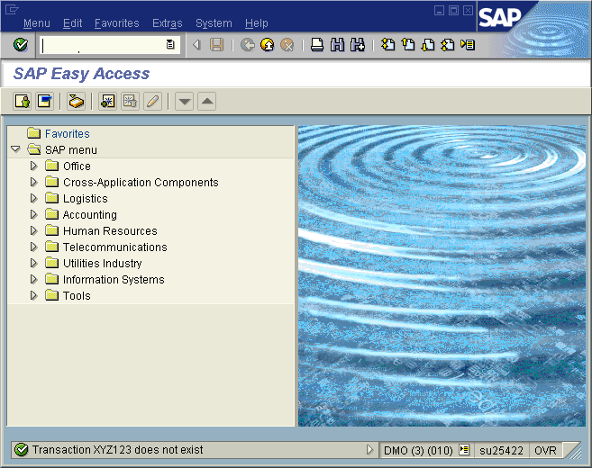
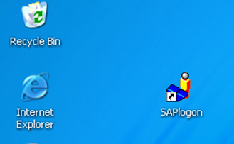
Log On to SAP
An SAP environment is a completely self-contained version of the SAP database, designated for a specific purpose.
SAP ECC is a client system. Each user session only accesses data on the client that you selected when you logged on.
Notes:
To log onto the SAP ECC system, begin by locating the SAP icon located on your desktop and double-clicking it. This launches an SAP Easy Access screen that displays the SAP menu.

Slide 11
SAP Screen Features
A typical SAP screen has seven main areas:
Screen Header
Menu Bar
Standard Toolbar
Title Bar
Navigation Toolbar
Screen Body
Status Bar
Notes:
Screen Header – Displays standard Windows buttons such as minimize, maximize, and close. On a PC, the Screen Header also contains the Stop Transaction button on the upper left corner. This button can be used for stopping transactions and reports that have already been run.
Menu Bar – Contains menus for the functional and administrative areas of the system. As you navigate through SAP screens, the options on the Menu Bar change, but every Menu Bar contains System and Help. Clicking on the System option on the Menu Bar opens a drop down menu of useful functions such as Create session, End session and Log off.
Standard Toolbar – Contains the Command field and the standard SAP Toolbar buttons.
Title Bar – Displays the name of the screen you are working on.
Navigation Toolbar – Contains the SAP Standard Menu, SAP User Menu buttons and Favorites. When you are in a transaction, the Navigation Toolbar is replaced by the Application Toolbar. The Application Toolbar provides quick access to commonly used functions.
Screen Body – Displays different elements depending on where you are in the system.
Status Bar – Located at the bottom of the SAP screen, displays system messages and other session information.

Slide 12
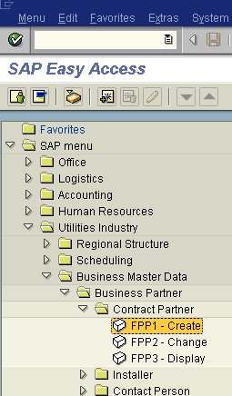
Transaction Codes
Each function in SAP ECC has a transaction code associated with it. Transaction codes are not displayed in the default view on the SAP Easy Access Menu, but you can enable this functionality.
The Navigation Area is made up of folders and sub-folders.
Click triangles to expand and collapse the menu tree to find the desired transaction.
Notes:
A transaction code or T-Code for short are letters, numbers, or both that make up a unique code that takes you directly to an application or the first screen of a task.
To use the Menu Tree to locate a transaction, from the SAP Easy Access screen, click on the SAP Menu icon to expand the SAP Standard menu tree. The first-level folders are displayed; select the appropriate folder and double-click on the arrow next to it to expand it. Continue drilling down in this manner until SAP displays the transaction you are seeking. Once you arrive at the transaction, double-click on it to access the initial transaction screen.
Please note that while the standard menu displays all SAP transactions, you are only able to access those transactions associated with your assigned role.

Slide 13

Practice
Scenario:
Navigate between the SAP User Menu and the SAP Standard Menu, open and close menu folders, display transaction codes.
Exercise: 1.1 Log on to SAP and Navigate the
SAP Easy Access Menu

Slide 14

Check Your Understanding
Name the two menus that will always display on the Menu Toolbar, regardless of the transaction you are in.
Explain the difference between the SAP Standard Menu and the SAP User Menu.
Notes:
System Menu and Help Menu
The SAP Standard Menu shows all transactions while the SAP User Menu shows only those transactions a user has the security role to execute.

Slide 15
Introduction and EAM Process overview
Module 2

Slide 16
Module Objectives
Upon completion of this module, you should be able to:
Provide an overview of the EAM process in SAP
Provide an overview of the work order process flow in SAP

Slide 17
Overview EAM Process Flow
Corrective Maintenance
Unplanned Corrective Maintenance
Emergency Maintenance
Preventative Maintenance
Parts/ Supplies
Pre-Defined Work Steps
External Services
Create Work Order
Plan & Schedule Work Order
Execute Work Order
Settle and Close Work Order
Notifications
Labor
Preventive Maintenance Work Order
Material Requisitions
Reporting
Notes:
A Planner receives a notification (preventive, corrective, emergency, etc.) to create a work order. A planned work order includes pre-defined work steps, labor cost associated with the work, parts/supplies needed, and any external services that are needed as well. The work order is scheduled by the Planner, which assigns it to the employee tasked to complete the order. Once complete, the work order is marked “technically complete”. Batch settlement is generated monthly to close the work order on the financials side. After that is complete, the planner can access the work order again and officially close it. Reports can be generated by Management to review detailed status information for the work order.

Slide 18

Overview Work Order Process Flow
Event Processed Thru Output Completed
Planner OR Work Work Order Order Closed
Corrective Maintenance
Unplanned Corrective Maintenance
Emergency Maintenance
Preventative Maintenance
Notification
Processed
Processed
SAP Automatic Work Order creation
Notes:
The work order process starts with a Planner receiving a notification. These events include Corrective Maintenance, Unplanned Corrective Maintenance, and Emergency Maintenance. Preventive Maintenance typically flows straight into SAP for Work Order creation (SAP creates the notification in the background). Upon completion, the planner closes the work order, and an EAM Mgr/Admin generates the necessary reports for detailed order review.

Slide 19
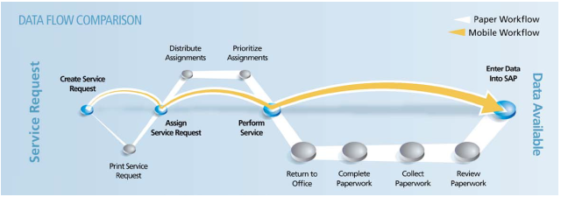
Benefits of an Electronic Process
The graphic displays the difference between manual processing and processing using SAP.

Slide 20
Check Your Understanding
What are the five steps that make up the EAM process flow?
Notes:
1. Notifications, Create Work Order, Plan & Schedule Work Order, Execute Work Order, Settle and Close Work Order

Slide 21

Module Summary
Having completed this module, you should be able to:
Provide an overview of the EAM process in SAP
Provide an overview of the work order process flow in SAP

Slide 22
Manage Notifications
Module 3

Slide 23
Module Objectives
Upon completion of this module, you should be able to:
Define key terms and concepts
Define a notification
Create a notification
Change a notification

Slide 24
Key Terms and Definitions
Key Term | Definition
Maintenance Notification | Means with which company notifications are created and managed in the area of Plant Maintenance or operations and management.
Maintenance Notification in Process | The processing status of a maintenance notification. If order processing is not active in the system, "put in process" means that the planning phase is over and that the maintenance task can be performed. If order processing is active in the system, "put in process" means that the maintenance notification has been processed by a maintenance planner. If order processing is active, this status does not have to be set. A maintenance notification can be created and assigned to an order. In this case the maintenance tasks are planned in the order.

Slide 25
Overview EAM Process Flow
Corrective Maintenance
Unplanned Corrective Maintenance
Emergency Maintenance
Preventative Maintenance
Parts/ Supplies
Pre-Defined Work Steps
External Services
Create Work Order
Plan & Schedule Work Order
Execute Work Order
Close and Settle Work Order
Notifications
Labor
Preventive Maintenance Work Order
Material Requisitions
Reporting
Notes:
This slide highlights the part of the process currently being reviewed. A Planner receives a notification (preventive, corrective, emergency, etc.) to create a work order.

Slide 26

What is a Notification?
A notification is used to capture technical information and assign tasks that do not involve the tracking of costs. The user can create a maintenance order from the PM notification
An existing notification can be copied to reduce data entry time

Slide 27
Notification Types
The Planner creates a work order from the PM notification. The notification types to be used at Loudoun Water are as follows:
M1: Corrective - Used for normal or routine repairs or malfunctions that do not severely affect the output of the equipment
M2: Malfunction Report - Used when equipment has failed and to track Mean Time To Repair (MTTR) and Mean Time Between Repairs (MTBR) statistics each month
M3: Activity Report - Used to record activities (work) that are minor in nature and no work order has to be created for them but a history of the event needs to be recorded. Example; fire extinguisher checks were completed this month

Slide 28
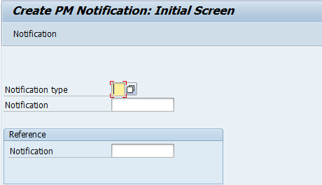
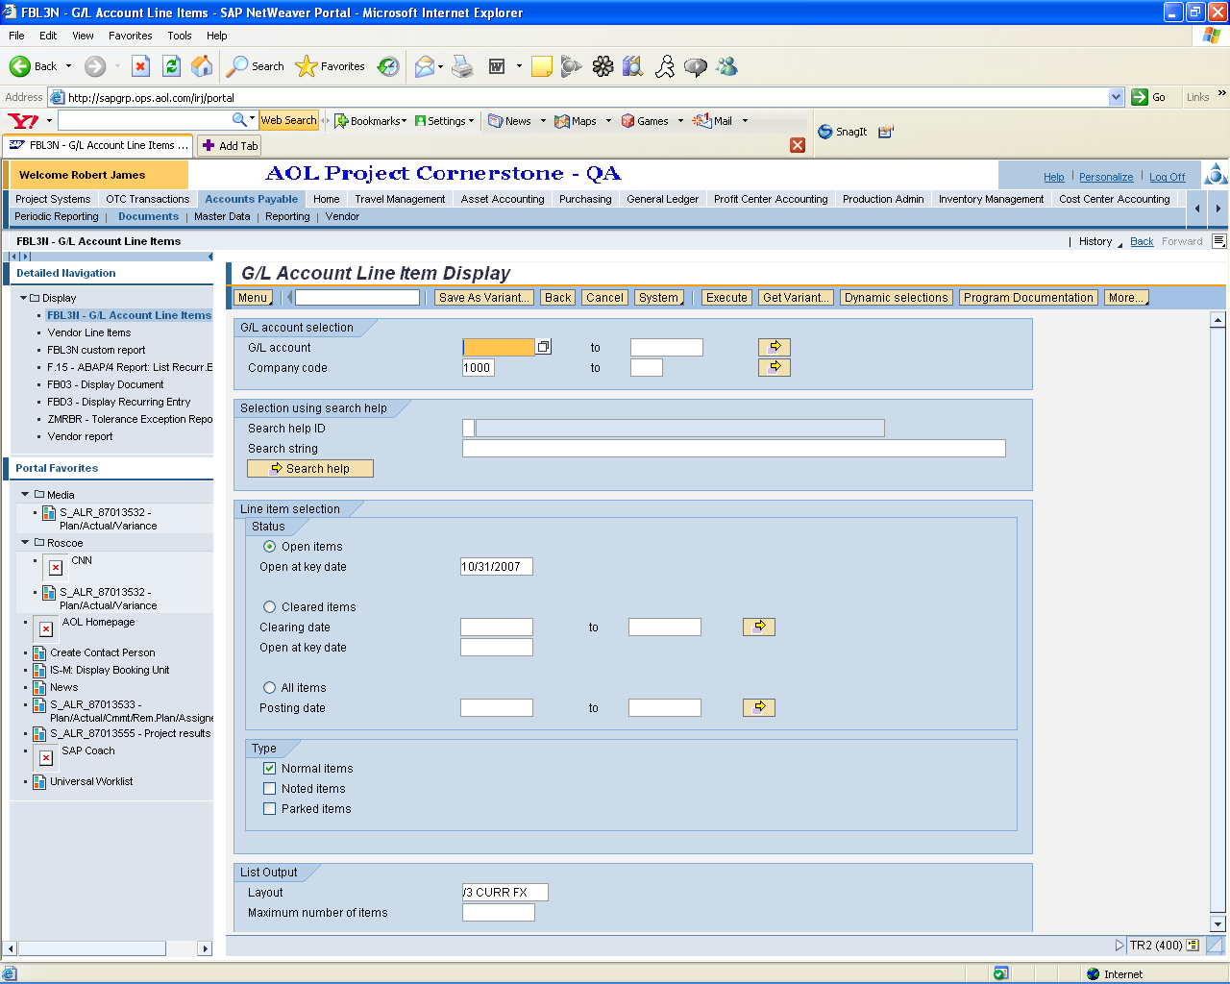
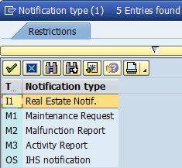
Notification Types
Select the notification type needed using transaction IW21.
1
Click the Matchcode icon to display a list of Notification Types.
Select the notification needed and continue.
1
2
2

Slide 29

Demonstration
Activity Name: Create a Notification
Transaction Name:
  Create PM Notification
  Transaction Code:
  IW21
  Path:
      Logistics > Plant Maintenance >
      Maintenance Processing > Notification > Create (General)

Slide 30
Practice
Scenario: You are tasked with creating a maintenance request notification to repair a malfunctioning pump.
Exercise: 3.1 Create a Notification

Slide 31
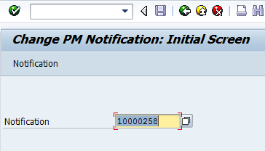
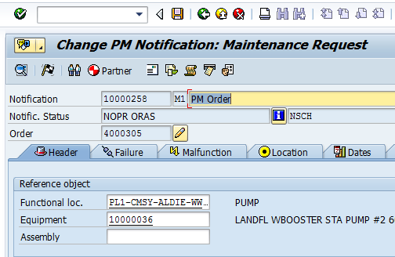
Change a Notification
Use transaction IW22 to make changes to a notification that has been previously created. Changes can include adding equipment, work description changes, or adding personnel.
Enter the Notification number and click the Enter button to continue.
Enter any necessary changes and click the Save button to save your changes.
1
1
2
2

Slide 32
Demonstration
Activity Name: Change a Notification
Transaction Name:
  Change PM Notification
  Transaction Code:
  IW22
  Path:
      Logistics > Plant Maintenance >
      Maintenance Processing > Notification > Change

Slide 33
Practice
Scenario: The equipment number for an existing notification needs to be updated with a different number.
Exercise: 3.2 Change a Notification

Slide 34
Check Your Understanding
What is a notification used for?
What are the four events that trigger the need to create a notification?
What are the notification types mostly used at Loudoun Water?
Notes:
1. A notification is used to capture technical information and assign tasks that do not involve the tracking of costs.
2. Corrective Maintenance, Unplanned Corrective Maintenance, Emergency Maintenance, and Preventive Maintenance
3. M1: Corrective - Used for normal or routine repairs or malfunctions that do not severely affect the output of the equipment
M2: Malfunction Report - Used when equipment has failed and to track Mean Time To Repair (MTTR) and Mean Time Between Repairs (MTBR) statistics each month
M3: Activity Report - Used to record activities (work) that are minor in nature and no work order has to be created for them but a history of the event needs to be recorded. Example; fire extinguisher checks were completed this month

Slide 35
Module Summary
Having completed this module, you should be able to:
Define key terms and concepts
Define a notification
Create a notification
Change a notification

Slide 36
Manage Work orders
Module 4

Slide 37
Module Objectives
Upon completion of this module, you should be able to:
Define key terms and concepts
Create a work order
Create a work order from a notification
View an assigned work order
Release a work order
Return materials to stock
Close a work order
Define the process for scheduling emergency work

Slide 38
Key Terms and Definitions
Key Term | Definition
Maintenance Location | A combination of main work center and plant of the main work center.
Maintenance Order | A detailed planning aid for maintenance tasks to be performed. Particular order types are the investment order, the calibration order, and the refurbishment order. You can use an order to: ■Plan tasks with specific reference to type, scope, deadlines, and resources ■Monitor the performance of tasks ■Define rules for account assignment and settlement, as well as for the budget ■To record, display, and settle the costs generated by the tasks

Slide 39
Overview EAM Process Flow
Corrective Maintenance
Unplanned Corrective Maintenance
Emergency Maintenance
Preventative Maintenance
Parts/ Supplies
Pre-Defined Work Steps
External Services
Create Work Order
Plan & Schedule Work Order
Execute Work Order
Settle and Close Work Order
Notifications
Labor
Preventive Maintenance Work Order
Material Requisitions
Reporting
Notes:
This slide highlights the part of the process currently being reviewed. A planned work order includes pre-defined work steps, labor cost associated with the work, parts/supplies needed, and any external services that are needed as well. The work order is scheduled by the Planner, which assigns it to the employee tasked to complete the order. Once complete, the work order is marked “technically complete”. Batch settlement is generated monthly to close the work order on the financials side. After that is complete, the planner can access the work order again and officially close it.

Slide 40
Managing Work Orders
A work order is a detailed work planning document used for tracking resources, components, costs, and labor required to complete specific maintenance work
Work orders can be created with or without a notification
An existing order can be copied to reduce data entry time
Use transaction IW38 to close a work order once work is complete

Slide 41


Work Order Types vs. Maintenance Types
Work Order Types
    A classification for orders
    Used to group orders based on certain components
    Ex: PM01 (PM) for maintenance orders
Maintenance Types
    Type of maintenance activity
    Activities can be divided into repairs, shutdowns, inspections, etc.
    Ex: Preventive Maintenance

Slide 42
Work Order Types
The standard work order types for maintenance are:
CM Corrective maintenance (planned and scheduled)
EM Emergency Work (unplanned/unscheduled)
UCM Unplanned corrective work (unplanned & scheduled)
PM Preventive/predictive Maintenance
(planned/scheduled by SAP)

Slide 43
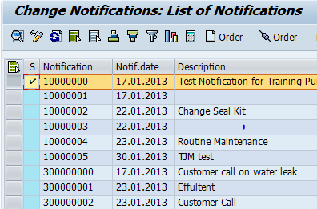
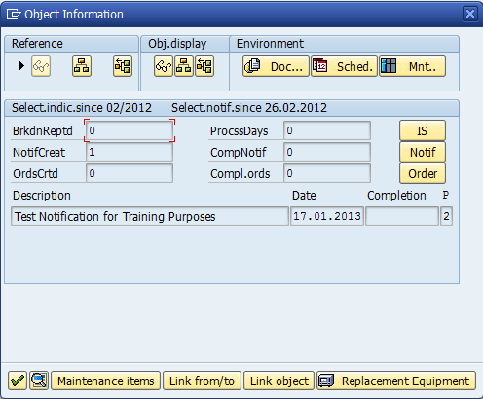
Create an Order From a Notification
SAP gives you the option of creating an order directly from a notification using transaction IW28.
1
Click the Create Order icon to create an order from a notification.
Enter any necessary object information, then click the Enter icon to go to the Create Corrective/Routine Work Order: Central Header screen.
1
2
2

Slide 44
Demonstration
Activity Name: Create a Work Order From a Notification
Transaction Name:
  Change Notifications: Selection of Notifications
  Transaction Code:
  IW28
  Path:
      Logistics > Plant Maintenance >
      Maintenance Processing > Notification > List Editing > Change

Slide 45
Practice
Scenario: You have received a PM notification and need to create a work order.
Exercise: 4.1 Create a Work Order from a Notification

Slide 46
Managing Emergency Work in SAP
Emergency work is considered to be a life or death scenario, or imminent danger to public safety. When confronting a situation as such:
Work is done immediately with a work order being created and closed after the work has been completed
Work orders can remain open in the event a part that is needed, is not immediately available. Once the part is available and the work is completed, the work order can be closed

Slide 47
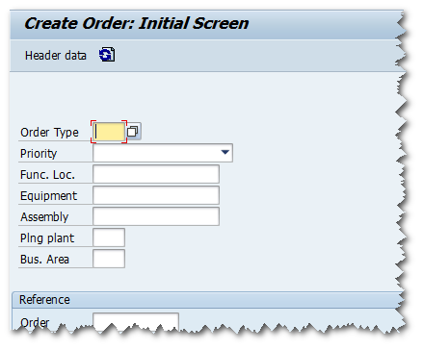
Create a Manual Work Order
In an emergency situation, a work order is created manually as there is not a notification available to initiate it. Use transaction IW31 to create the work order.

Slide 48
Demonstration
Activity Name: Create a Manual Work Order
Transaction Name:
  Create Order
  Transaction Code:
  IW31
  Path:
      Logistics > Plant Maintenance >
      Maintenance Processing > Order > Create (General)

Slide 49
Practice
Scenario: A work order is required to complete corrective maintenance to replace a faulty meter.
Exercise: 4.2 Create a Manual Work Order

Slide 50
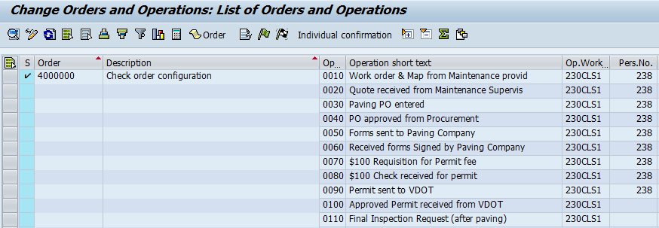
View an Assigned Work order
Use transaction IW37N to display general work order information, which includes the personnel number in the Pers.No field.

Slide 51
Adding Materials, Time, and Resources
Work orders contain important information needed for the job to be assigned and completed:
Materials necessary for the work to be completed are added to the order
Job start and finish times are added to the order
Each order is assigned to a technician to be completed.

Slide 52
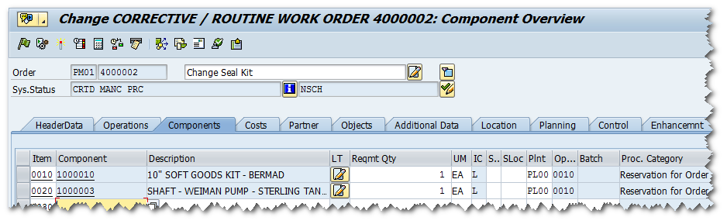
Adding Materials to an Order
Use the Components tab to add materials needed to complete the order.

Slide 53
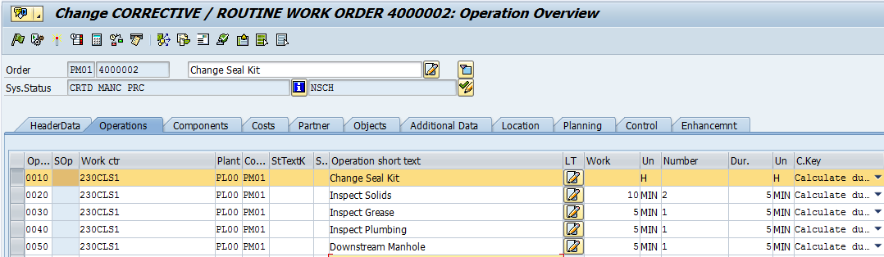
Adding Time to an Order
By entering the number of resources needed in the Number field, the work duration automatically calculates and populates the Work field.

Slide 54
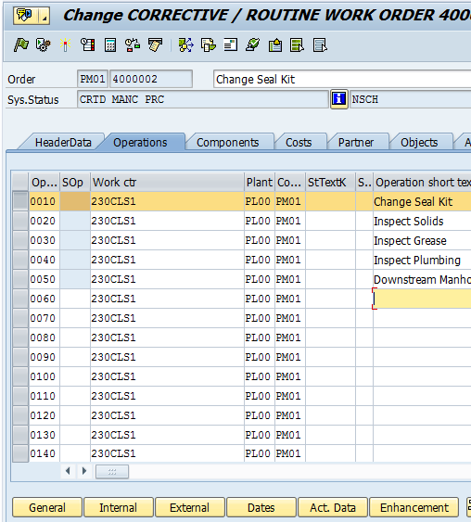
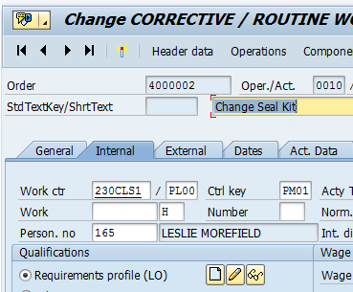
Adding Resources to an Order
Adding a resource to an order is a two step process.
Highlight an operation and click the Internal button to continue.
Enter the personnel number in the Person. no field.
1
2
2
1

Slide 55
Demonstration
Activity Name: Add Materials, Resources, and Time to a Work Order
Transaction Name:
  Change Order
  Transaction Code:
  IW32
  Path:
      Logistics > Plant Maintenance >
      Maintenance Processing > Order > Change

Slide 56
Practice
Scenario: You need to add information to a work order that has been recently created.
Add a 3 ¼” hose to the order
Enter a 2 in the Number field to calculate duration
Add a resource to the order
Exercise: 4.3 Add Materials, Time, and Resources to a Work order

Slide 57
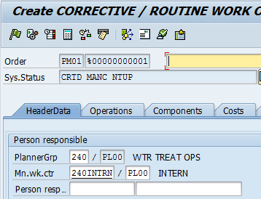
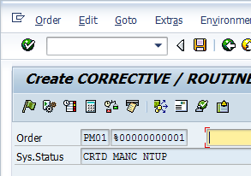
Release a Work Order
In order for the work order to be available for review, it must first be released. To release the work order, click the Release icon or follow the menu path: Order Functions Release
0
1
2

Slide 58
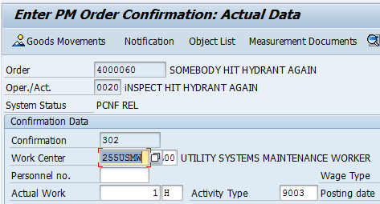
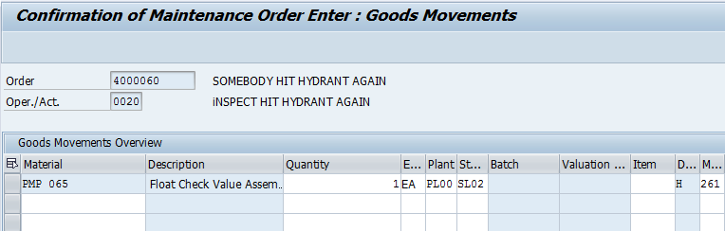
Return Materials to Stock
When necessary, unused materials from an order can be returned to warehouse stock using transaction IW41.
Click the Goods Movements icon to access the Goods Movements screen.
In the Movement Type field, change 261 to 262 (Consumption for order from warehouse –reversal).
1
1
2
2

Slide 59
Close a Work Order
Closing a Work Order is a three step process:
When an order is complete, access IW38 or IW72 to display the work order and click the Complete (Technically) icon
Once it has been marked technically complete, a batch settlement can be generated to close the financials of the order
Access the order once again and follow the menu path: Order Functions Complete Complete (business) to officially close the work order

Slide 60
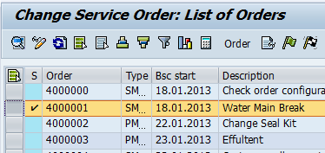
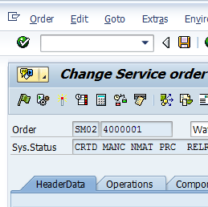
Close a Work Order
Before closing a work order, you must first mark the order as technically complete. After batch settlement, it can then be marked as business complete.
Click the Complete (Technically) icon to technically close the work order.
After batch settlement has been generated, follow the menu path Order – Functions – Complete – Complete (business) to officially close the order.
1
1
2
2

Slide 61
Demonstration
Activity Name: Close a Work Order
Transaction Name:
  Change PM Order: Selection of Orders
  Transaction Code:
  IW38
  Path:
      Logistics > Plant Maintenance >
      Maintenance Processing > Order > Order List > Change

Slide 62
Practice
Scenario: Corrective maintenance for an order has been completed. This exercise requires a two step process.
First, you must mark the order technically complete
Second, assuming the batch settlement has completed the financial closing, you must then officially close the work order
Exercise: 4.4 Close a Work Order

Slide 63
Check Your Understanding
True or False: A work order cannot be created without a notification.
Before a work order can officially be closed, what must first be generated?
Notes:
False: A work order can be created with or without a notification.
Batch settlement. This process is currently scheduled to generate once a month, but can be generated any other time when needed.

Slide 64
Module Summary
Having completed this module, you should be able to:
Define key terms and concepts
Create a work order
Create a work order from a notification
View an assigned work order
Release a work order
Return materials to stock
Close a work order
Define the process for scheduling emergency work

Slide 65
Manage Planning Activities
Module 5

Slide 66
Module Objectives
Upon completion of this module, you should be able to:
Define key terms and concepts
Create/Change a material
Create a material BOM
Create an equipment BOM
Commission/Decommission equipment
Manage measurement points
Review stock

Slide 67
Key Terms and Definitions
Key Term | Definition
Maintenance Bill of Material | A list used to describe the structure of a technical object and to assign spare parts to the object for maintenance.
Bill of Material | A complete, structured list of the components that make up an object. The list contains the description, the quantity, and unit of measure. The components are known as BOM items. ■BOM categories In the SAP System, BOMs can form different objects and manage object- related data. You can maintain the following BOM categories, for example: ■Material BOM ■Document structure ■Equipment BOM ■Functional location BOM ■Sales order BOM

Slide 68
Overview EAM Process Flow
Corrective Maintenance
Unplanned Corrective Maintenance
Emergency Maintenance
Preventive Maintenance
Parts/ Supplies
Pre-Defined Work Steps
External Services
Create Work Order
Plan & Schedule Work Order
Execute Work Order
Settle and Close Work Order
Notifications
Labor
Preventive Maintenance Work Order
Material Requisitions
Reporting
Notes:
Prior to notifications or work orders being created; materials/equipment, employees, labor categories, etc., must be setup in SAP. During the creation of the work order, equipment and labor activities can be added as well. This module focuses on those activities that help form the foundation of the EAM process flow.

Slide 69
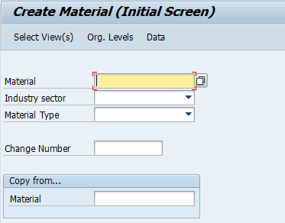
Managing Materials in SAP
Material masters are created when a material required is not defined in the material master
Before a material can be used in the system, it must be created for each plant. At a minimum, the material must have a description and a base unit of measure assigned on the basic data view
Additional department views (i.e. Sales, Purchasing, MRP, and Warehouse) can be added at a later time by extending the material. As additional plants are added, a material needs to be extended to the plants before it can be used there

Slide 70
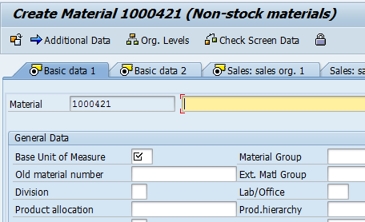
Creating a Material in SAP
Once a need to define a Production Resource/Tool as a material has been identified, the Planner must access transaction MM01 to create the material.
1
Enter the Industry sector and the Material Type. and click the Enter button to continue. SAP automatically populates the material field.
After selecting the views that are needed to enter material information click the Enter button to go to the Create Material XXXX (XXXX) screen. Enter the material information as necessary.
1
2
2

Slide 71
Demonstration
Activity Name: Create a Material
Transaction Name:
  Create Material (Initial Screen)
  Transaction Code:
  MM01
  Path:
      Logistics > Materials Management >
      Material Master > Material > Create (General)> Immediately

Slide 72
Practice
Scenario: A new 3 ¼” pipe must be added to SAP as a stock material for tracking purposes.
Exercise: 5.1 Create a Material

Slide 73
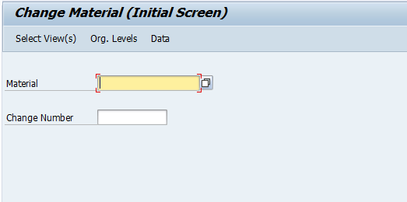
Changing a Material
Enter the material and select the views that changes need to be applied to
Changes can include extending materials to another plant or adding additional views that may not have been selected previously
Use transaction code MM02 to implement all changes necessary

Slide 74
Demonstration
Activity Name: Change a Material
Transaction Name:
  Change Material (Initial Screen)
  Transaction Code:
  MM02
  Path:
      Logistics > Materials Management >
      Material Master > Material > Change > Immediately

Slide 75
Practice
Scenario: A change needs to be made to the new 3 ¼” pipe that has recently been added to SAP.
Add the Purchasing Group and MRP Group to the MRP1 view
Add the Valuation Category to the Accounting 1 view
Exercise: 5.2 Change a Material

Slide 76
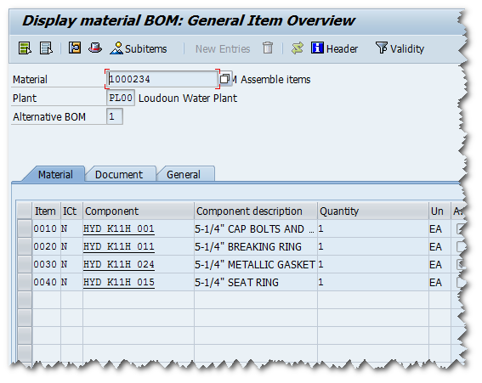
What is a BOM?
Bill of materials (BOMs) contain essential master data for integrated materials management and production control
A bill of material is a complete, formally structured list of components that makes up a product or assembly. The list contains the object number of each component, together with the quantity and unit of measure. The components are known as BOM items

Slide 77
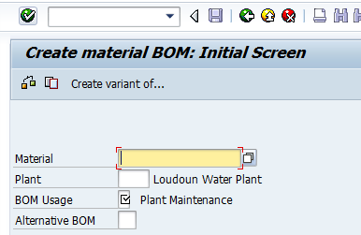
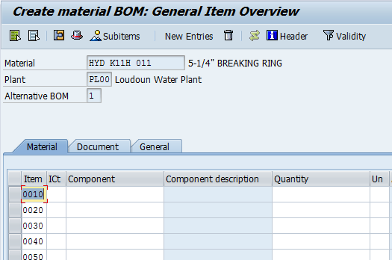
Creating a BOM
Materials must first exist in SAP before creating a bill of material. Materials are created and entered into SAP by Master Data. Once material and component numbers exist, a BOM can be created using transaction CS01.
Enter the Material, Plant, and BOM Usage information and click the Enter button to continue.
1
Enter each component that makes up the complete bill of material. The Item number for each denotes the order of assembly. When complete, click the Save button to save your BOM.
2

Slide 78
Demonstration
Activity Name: Create a Material BOM
Transaction Name:
  Create material BOM: Initial Screen
  Transaction Code:
  CS01
  Path:
      Logistics > Plant Maintenance >
      Management of Technical Objects > Bill of Material > Material BOM > Create

Slide 79
Practice
Scenario: For inventory stock purposes, a bill of material for a 12x10 Pump must be created.
Exercise: 5.3 Create a Material BOM

Slide 80
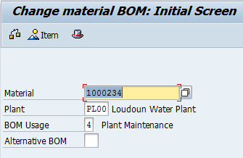
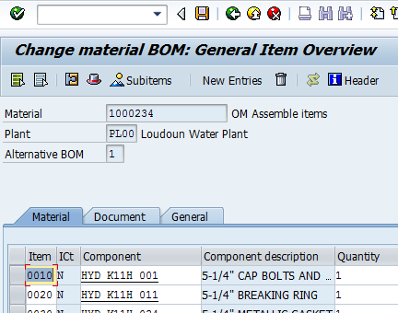
Changing a BOM
On occasion, it may be necessary to change a component, the item number, or the quantity in a BOM. Access transaction CS02 to complete any necessary changes.
1
Enter the Material, Plant, and BOM Usage information and click the Enter button to continue.
Make any necessary changes to the BOM and click the Save button to save your changes.
1
2
2

Slide 81
Demonstration
Activity Name: Change a Material BOM
Transaction Name:
  Change material BOM: Initial Screen
  Transaction Code:
  CS02
  Path:
      Logistics > Plant Maintenance >
      Management of Technical Objects > Bill of Material > Material BOM > Change

Slide 82
Practice
Scenario: The bill of material recently created for a 12x10 Pump must be changed.
Add a Caps Bolts/Nuts component
Change the Item number of the Lock Nut from 0030 to 0015
Exercise: 5.4 Change a Material BOM

Slide 83
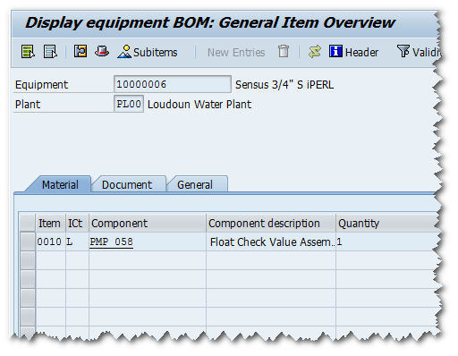
What is an Equipment BOM?
A bill of material for a piece of maintenance equipment is used to describe the equipment components, maintenance requirements, or the assignment of spare parts
An equipment BOM can be used to track preventive maintenance for Fleet vehicles and general parts servicing

Slide 84
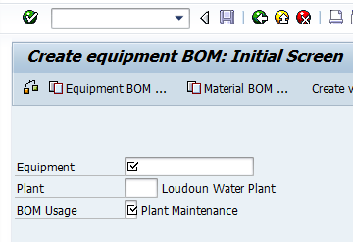
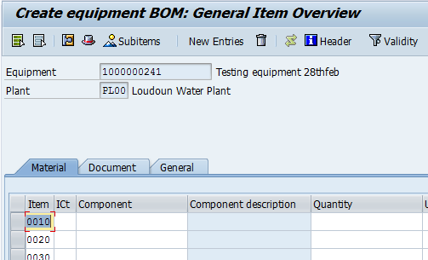
Creating an Equipment BOM
For an equipment BOM, an equipment item can only contain one BOM. If a BOM exists for this equipment, it must be changed. An equipment BOM is created using transaction IB01.
Enter the Equipment, Plant, and BOM Usage information and click the Enter button to continue.
1
Enter each component that makes up the complete bill of material. The Item number for each denotes the order of assembly. When complete, click the Save button to save your BOM.
2

Slide 85
Demonstration
Activity Name: Create an Equipment BOM
Transaction Name:
  Create equipment BOM: Initial Screen
  Transaction Code:
  IB01
  Path:
      Logistics > Plant Maintenance >
      Management of Technical Objects > Bill of Material > Equipment BOM > Create

Slide 86
Practice
Scenario: An equipment BOM must be created to add leadtimes to a backflow device for preventive maintenance purposes.
Exercise: 5.5 Create an Equipment BOM

Slide 87
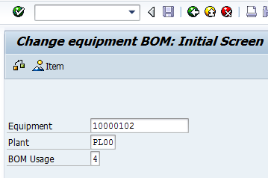
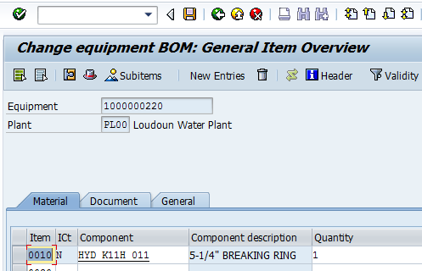
Changing an Equipment BOM
To add components or change validity dates, access transaction IB02 to complete any necessary changes.
1
Enter the Material, Plant, and BOM Usage information and click the Enter button to continue.
Make any necessary changes to the BOM and click the Save button to save your changes.
1
2
2

Slide 88
Demonstration
Activity Name: Change an Equipment BOM
Transaction Name:
  Change equipment BOM: Initial Screen
  Transaction Code:
  IB02
  Path:
      Logistics > Plant Maintenance >
      Management of Technical Objects > Bill of Material > Equipment BOM > Change

Slide 89
Practice
Scenario: An equipment BOM recently created for a Sierra 2500 HD4WD GMC Regular Cab Pickup must be changed.
Add a 5 ¼” Hose Cap component
Change the Item number of the Lock Nut from 0030 to 0010
Exercise: 5.6 Change an Equipment BOM

Slide 90
Purpose of Commission/Decommission
Commission, used to activate a vehicle after it’s been purchased. Decommission is the process of deactivating the vehicle when it is not going to be used anymore. Use IE01. Need information from John/Buddy.

Slide 91
Commission Equipment

Slide 92
Demonstration
Activity Name: Commission Equipment
Transaction Name:
  Create Equipment: Initial Screen
  Transaction Code:
  IE01
  Path:
      Logistics > Plant Maintenance >
      Management of Technical Objects > Equipment > Create (General)

Slide 93
Practice
Scenario: A new fleet vehicle has been purchased and must be commissioned in SAP before usage can begin.
Exercise: 5.7 Commission Equipment

Slide 94
Decommission Equipment
6rANhdgd

Slide 95
Demonstration
Activity Name: Decommission Equipment
Transaction Name:
  Change Equipment: Initial Screen
  Transaction Code:
  IE02
  Path:
      Logistics > Plant Maintenance >
      Management of Technical Objects > Equipment > Change

Slide 96
Practice
Scenario: A vehicle has reached the point where it must be removed from the fleet and resold. Before this can be done, the vehicle must be decommissioned in SAP.
Exercise: 5.8 Decommission Equipment

Slide 97
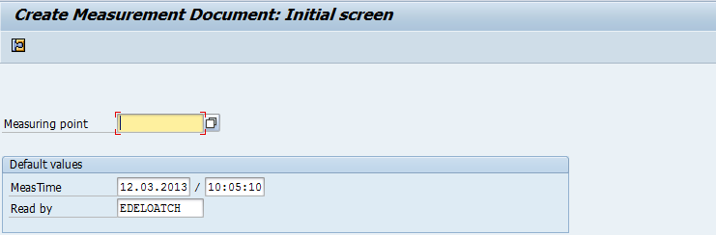
Measurement Document
Measurement values are needed to help track maintenance conditions for a given object
Measurement document is used to create either a measuring point or to take a counter reading
After a measurement has been taken at a measuring point or a counter, the data needs to be entered into the system

Slide 98
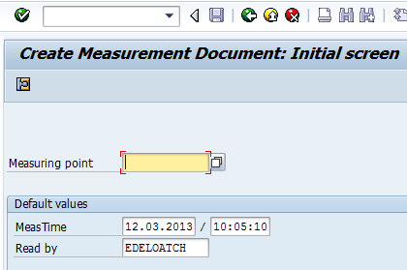
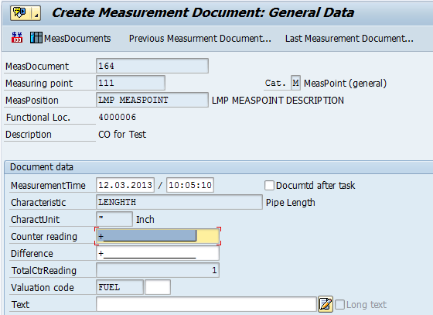
Creating a Measurement Document
Create a measurement document using transaction IK11.
1
Enter the Measuring Point and click the Enter button to continue.
Enter the document data needed in each field. When complete, click the Save button to save your information.
2

Slide 99
Demonstration
Activity Name: Create a Measurement Document
Transaction Name:
  Create Measurement Document: Initial Screen
  Transaction Code:
  IK11
  Path:
      Logistics > Plant Maintenance >
      Maintenance Processing > Bill of Completion Confirmation > Measurement Documents > Create

Slide 100
Practice
Scenario: A counter reading of 5000 miles needs to be entered for a fleet vehicle to help facilitate regularly scheduled oil change maintenance.
Exercise: 5.9 Create a Measurement Document

Slide 101
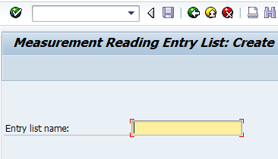
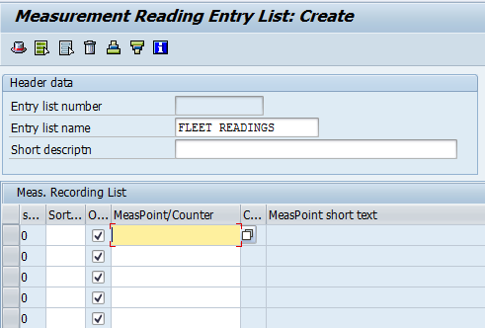
Measurement Reading Entry List
The Measurement Reading Entry List works as a “to-do” list for the worker. The reading list is used to group together multiple readings. Access the transaction using IK31.
Enter the Entry list name and click the Enter button to continue.
Enter each measurement point or counter reading as needed and click the Save button to save your entries.
1
1
2
2

Slide 102
Demonstration
Activity Name: Create a Measurement Reading Entry List
Transaction Name:
  Measurement Reading Entry List: Create
  Transaction Code:
  IK31
  Path:
      Logistics > Plant Maintenance >
      Management of Technical Objects > Environment > Measuring Points > Measurement Reading Entry List > Create

Slide 103
Practice
Scenario: You have completed three measurement point and five counter readings. For organization purposes, you need to create a measurement reading entry list.
Exercise: 5.10 Create a Measurement Reading Entry List

Slide 104
Module Summary
Having completed this module, you should be able to:
Define key terms and concepts
Create a material BOM
Create an equipment BOM
Commission/Decommission equipment
Manage measurement points
Review stock

Slide 105
Analytics & Reports
Module 6

Slide 106
Module Objectives
Upon completion of this module, you should be able to:
Define key terms and concepts
Describe Various reports related to the EAM Management process
Explain the purpose of selection criteria and multiple selection options
Generate a List Edit report in SAP

Slide 107
Key Terms and Definitions
Key Term | Definition
Malfunction Report | A maintenance notification describing a malfunction at a technical object. An employee, for example, from Production, can use a malfunction report to inform the maintenance department that an operational system is not functioning correctly, is not functioning or is producing poor results.

Slide 108
Overview EAM Process Flow
Corrective Maintenance
Unplanned Corrective Maintenance
Emergency Maintenance
Preventative Maintenance
Parts/ Supplies
Pre-Defined Work Steps
External Services
Create Work Order
Plan & Schedule Work Order
Execute Work Order
Settle and Close Work Order
Notifications
Labor
Preventive Maintenance Work Order
Material Requisitions
Reporting
Notes:
This slide highlights the process currently being reviewed. Reports can be generated to review detailed status information for the work order.

Slide 109
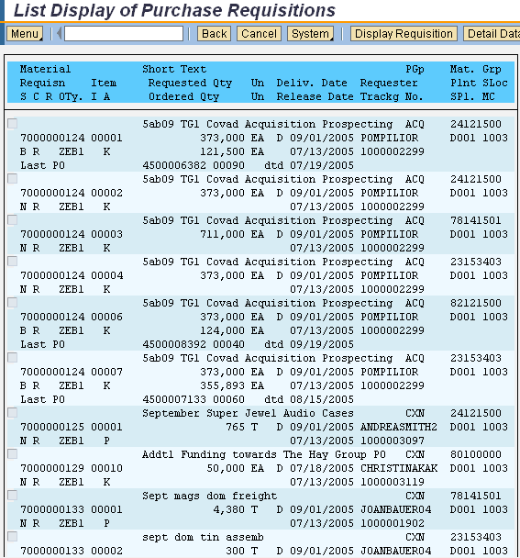

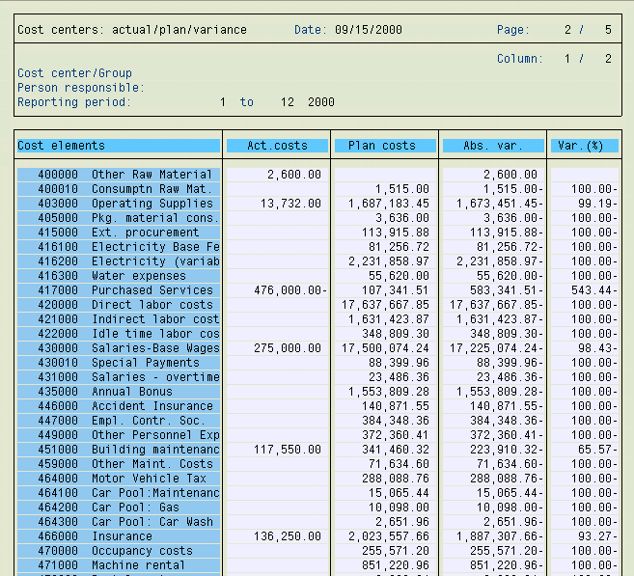

SAP ECC Reports
SAP ECC reports contain real-time data:
  Data in SAP ECC reports is up-to-date at any given time and reflects all posting activities as soon as they occur
  Reports in SAP ECC are organized by modules and applications
  You can access reports by navigating the SAP menu tabs or by using transaction codes
  Access to reports is restricted by the role(s) assigned to the user
List Display
Purchase Requisitions
Cost Center
Report
ECC Purchasing
Reporting
ECC Cost Center
Reporting
Notes:
You can add reports you use most often to your Favorites folder.
Access to reports is restricted by the role(s) assigned to the user – for example, not everyone has the ability to generate capital project reports. And for those that are able to generate budget reports, your access is limited to just your department. You are not be able to see another department’s budget.

Slide 110
Available Reports
Report | Purpose
IW28 – Change Notifications: Selection of Notifications | Displays a list of open or in process notifications
IW38 – Change PM orders: Selection of Orders | Displays a list of open or in process Plant Maintenance orders
IW58 – Change Service Notifications: Selection of Notifications | Displays a list of open or in process service notifications
IW72 – Change Service Order: Selection of Orders | Displays a list of open or in process service orders
IW37N – Change Orders and Operations: Selection of Orders and Operations | Display a list of open or in process orders and operations

Slide 111
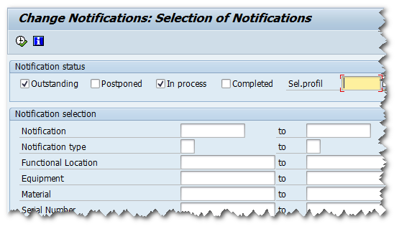
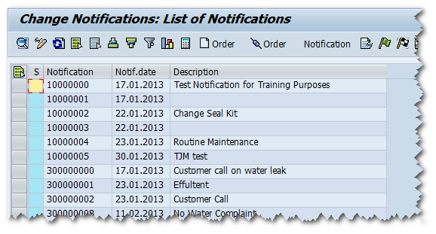
Displaying Notifications Report
1
2
Transaction IW28 used to display notifications.
Report results after initiating the transaction. Double click a line to display detailed information on the order.
1
2

Slide 112
Demonstration
Activity Name: Generate a Notifications Report
Transaction Name:
  Change Notifications: Selection of Notifications
  Transaction Code:
  IW28
  Path:
      Logistics > Plant Maintenance >
      Maintenance Processing > Notification > List Editing > Change

Slide 113
Practice
Scenario:
You have logged on to SAP. You need to generate a report that displays “outstanding” and “in process” notifications
Find and display the details for an “in process” notification for a water leak
Exercise: 6.1 Generate a notifications report

Slide 114
Demonstration
Activity Name: Generate a Service Order Report
Transaction Name:
  Change Service Order: Selection of Orders
  Transaction Code:
  IW72
  Path:
      Logistics > Customer Service >
      Service Processing > History > Order List > Change

Slide 115
Practice
Scenario:
You have logged on to SAP. You need to generate a report that displays “outstanding” and “in process” service orders
Find and display the details for an “outstanding” service order for a water main break.
Exercise: 6.2 Generate service order report

Slide 116
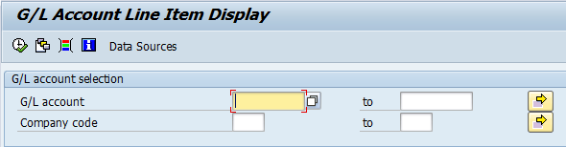
Enter Selection Criteria
Once you select the report that you want to run, you need to define the type and amount of information you want to be displayed in the report:
  Selection criteria are fields that you can use to enter values for retrieving data for the report
  Selection criteria fields vary depending upon the report you select
  Only data that matches the selection criteria are displayed in the report
Selection criteria field options change depending on the report you are generating
Notes:
The use of selection criteria offers the following benefits:
You can limit the length of the report
You can minimize the processing time needed by SAP for data retrieval
You can extract relevant data and exclude unwanted data
Because of the wealth of data in the SAP system, be very cautious of generating reports with vast amounts of data by using few or no selection criteria.

Slide 117
Using the Multiple Selection Option
One of the reporting tools used to produce very specific report results is the Multiple Selection button.
The Multiple Selection button allows you to enter very specific selection criteria to narrow the report results
Only use the multiple selection tools when you have a clear understanding of the data because the advanced selection tools are so specific that all criteria must be true to generate report results
In the Multiple Selection Criteria tabs you may include, exclude, or add operators to your specific selections
117

Slide 118
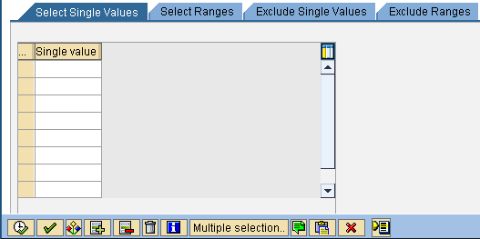
Multiple Selection Buttons
There are a four tabs and a number of buttons on the Multiple Selection dialog box to provide additional functionality.
Mix and match these multiple selection options to produce a complex and very specific search for report or query data.

Slide 119
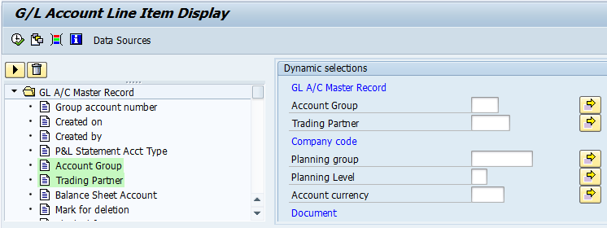
Specify Additional Selection Criteria
In addition to the selection criteria that are displayed on the screen, some reports allow you to specify additional fields that you can use as selection criteria via the Dynamic Selection option.
1
Click on the initial screen to display the Dynamic Selections
3
The selected field(s) appear on the screen. You can now enter values in these fields.
2
Double-click the field(s) you want to use as selection criteria.
Fields already selected are highlight in green; double-click to remove as selection criteria.
4
Click to return to the initial selection screen.

Slide 120
Demonstration
Activity Name: Create a Selection Variant
Transaction Name:
  Change Service Order: Selection of Orders
  Transaction Code:
  IW72
  Path:
      Logistics > Customer Service >
      Service Processing > History > Order List > Change
Notes:
Will need to identify criteria once training client is built.

Slide 121
Practice
  Scenario:
  As part of your duties, you monitor “outstanding” and in “process” work orders. To facilitate this process, you wish to create a Selection Variant.
  Enter selection criteria in the IW72 Change Service Orders: Selection of Orders list edit report for Order Type PM01, Functional Location PL1, and Plant for WorkCenter PL00
  Save your selection criteria values as a Personal Selection Variant and name it WO_your Last Name
  Exit the report without executing it
Exercise: 6.3 Create a Selection Variant
Notes:
Validate once training client is built.

Slide 122
Check Your Understanding
True or False: List Edit Reports allow you the option of displaying information that remains outstanding, currently in process, or completed.
True or False: Report results can only be viewed in SAP.
Notes:
True
False: Once generated, a report can be exported to Excel or re-formatted on the screen.

Slide 123
Module Summary
Having completed this module, you should be able to:
Define key terms and concepts
Describe Various reports related to the EAM Management process
Explain the purpose of selection criteria and multiple selection options
Generate a List Edit report in SAP

Slide 124
Summary

Slide 125

Course Summary
In this course you have learned to :
Define key terms and definitions
Explain the SAP log on process
Explain the EAM process flow
Create notifications in SAP
View assigned work orders
Manage work orders
Create measurement points
Manage bill of materials
Commission/Decommission equipment
Return material to stock
Generate an ad hoc report

Slide 126
Need Info for Help

Slide 127

Course Evaluation
Please visit the Learning Portal and complete the Course Evaluation located in the Help tab. The evaluations are anonymous and your input will help improve future training.
Go to the Learning Portal and open the Help tab, or type in the following address to start the survey:
  (Insert Survey Monkey link here)

Slide 128

Questions
What other questions do you have?

